Slide 1
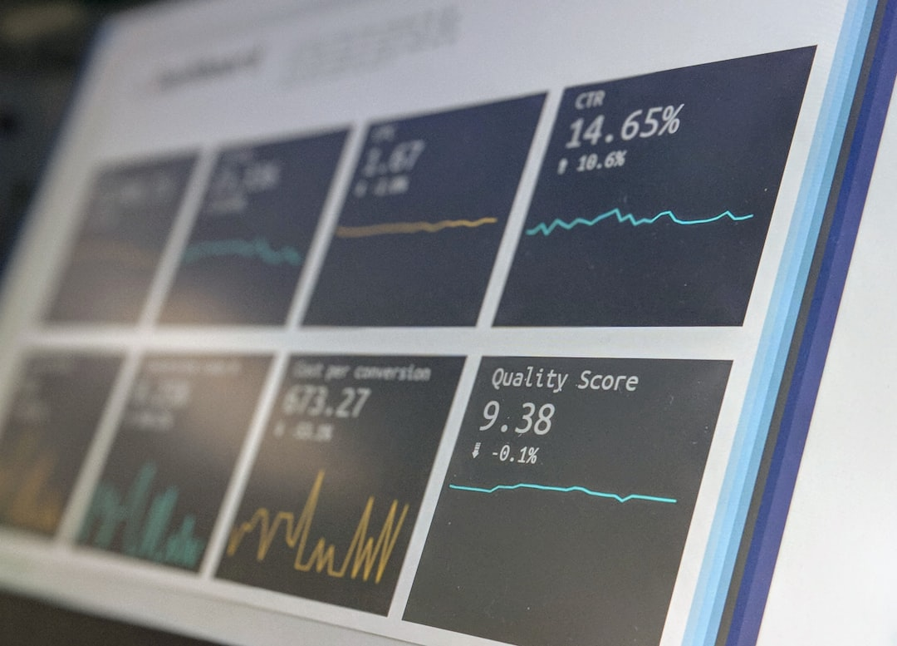
Introduction to Star Schema
Created by
Group 2

Slide 2
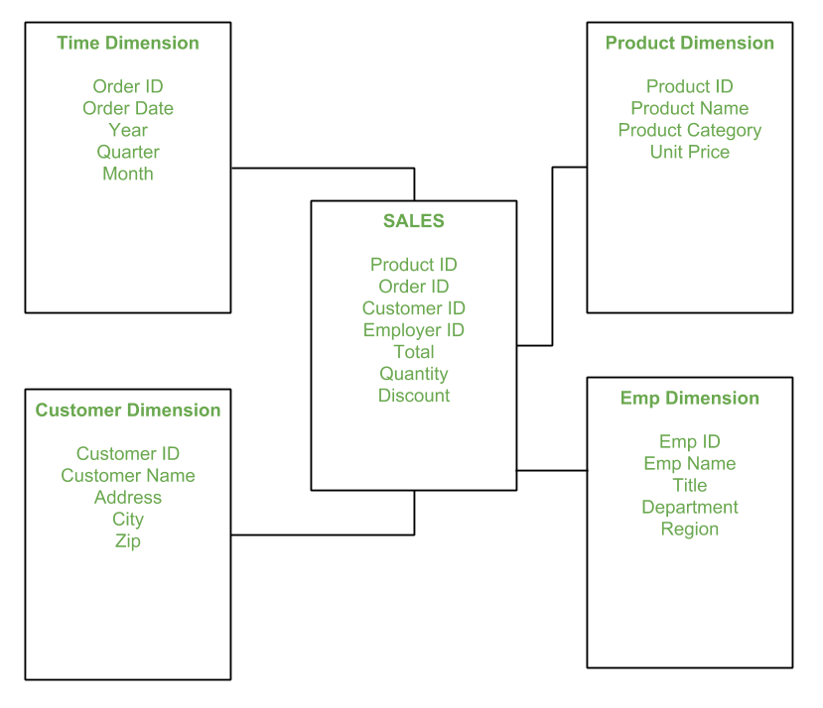
Star Schema Overview
Structure of Star Schema
The star schema is a database design used in data warehousing, where data is organized into fact tables and dimension tables. The fact table contains the measurable, quantitative data (like sales or order amounts), while dimension tables store descriptive attributes (like customer details, product details, or time).
Photos provided by Unsplash

Slide 3

Data Loading Process
The data loading process involves populating these tables with data from various source systems. This often requires transferring data from source tables into a format suitable for the star schema.
Photos provided by Unsplash

Slide 4
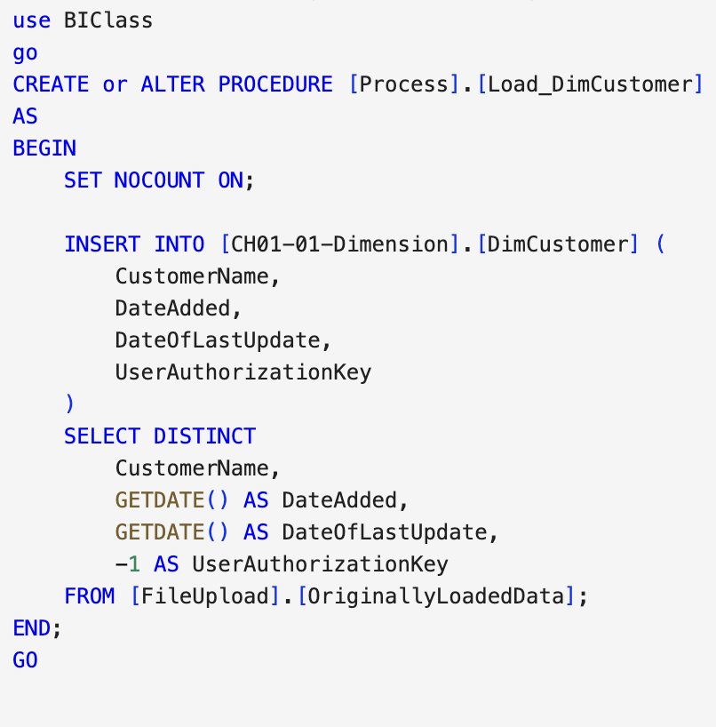
Stored Procedure
Understanding Stored Procedures
A stored procedure is a precompiled collection of one or more SQL statements that can be executed as a single call. Stored procedures are commonly used to automate repetitive tasks, such as data insertion, updates, and maintenance.
Notes:
Stored procedures help in:
Automating data loading processes
Ensuring consistency and reliability in data manipulation
Reducing redundancy by encapsulating complex logic into a single callable unit
Improving performance by reducing the need to repeatedly parse and optimize SQL queries

Slide 5
Stored Procedure Example
Stored Procedure Name: Process.usp_TrackWorkFlow
Objective: Tracks workflow progress by recording details such as start time, description, and row count.
Parameter Name | Data Type | Purpose
@StartTime | DATETIME2 | Indicates when the workflow step began.
@WorkFlowDescription | NVARCHAR | Provides a summary of the workflow step.
@WorkFlowStepTableRowCount | INT | Records the number of rows processed.
@UserAuthorizationKey | INT | Links to the user who authorized the step.
Output: Inserts a new record into the Process.WorkflowSteps table

Slide 6
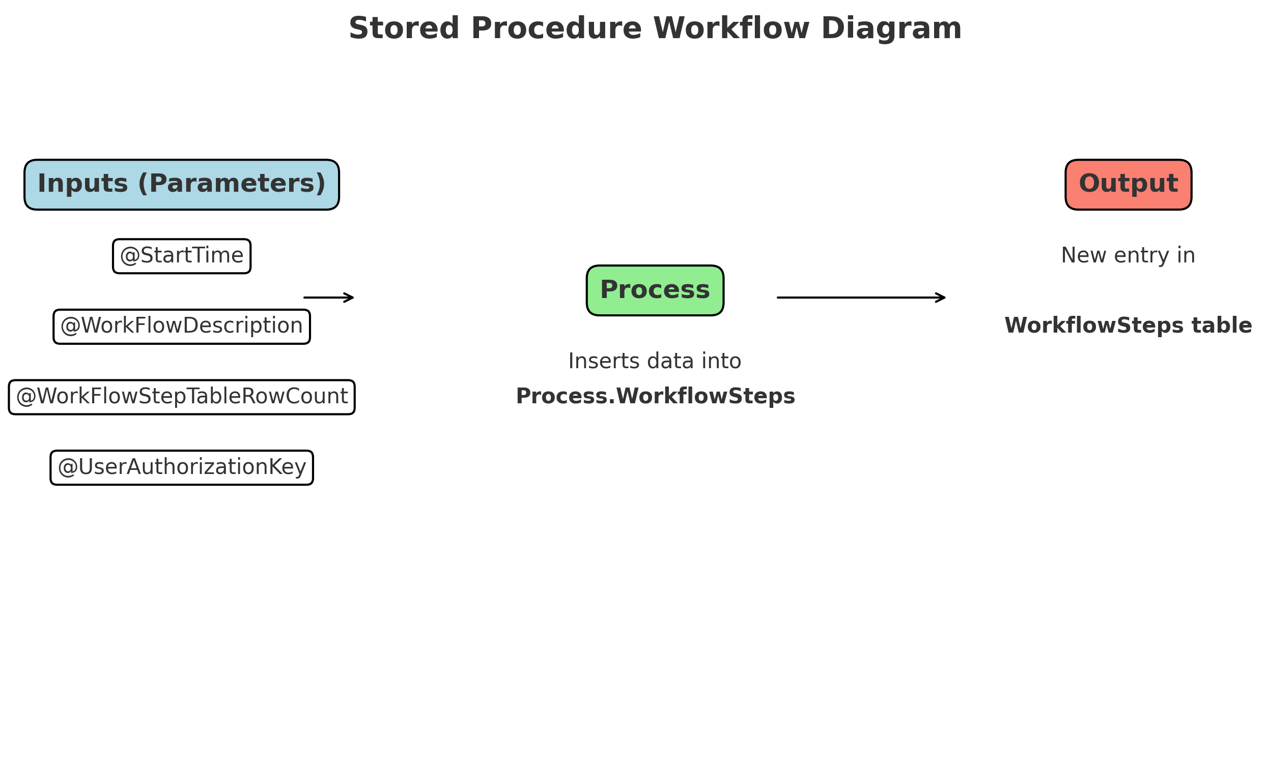
SQL Code for Stored Procedure
INSERT INTO Process.WorkflowSteps (
WorkFlowStepKey,
WorkFlowStepDescription,
WorkFlowStepTableRowCount,
StartingDateTime,
EndingDateTime,
UserAuthorizationKey
)
VALUES (
NEXT VALUE FOR Process.WorkflowStepSequence,
@WorkFlowDescription,
@WorkFlowStepTableRowCount,
@StartTime,
SYSDATETIME(),
@UserAuthorizationKey
);

Slide 7
Workflow Tracking Procedure
Input Parameters
Execution Logic
Output Management
This procedure takes several parameters to track workflow progress, including start time, workflow description, and authorization.
It executes an insert statement into the Process.WorkflowSteps table, ensuring accurate logging for every workflow step executed.
The output inserts a new record capturing all details about the workflow step, aiding in monitoring and tracking performance.

Slide 8
Stored Procedures for Star Schema Loading and Workflow Tracking
Jascharan’s Procedures Video

Slide 9

Benefits of Procedures
Enhanced Automation
Consistency and Performance
Stored procedures automate repetitive tasks, minimizing manual input and allowing for scheduled executions to enhance operational efficiency.
Using stored procedures ensures data manipulation is consistent across operations, improving performance by minimizing parsing and optimizing single execution paths.

